Slide 1


Slide 2
Common CSS Properties
Border
Border-Radius
Outline
Padding
Margin
Overflow
Box-Sizing
Float
Clear
Background

Slide 3
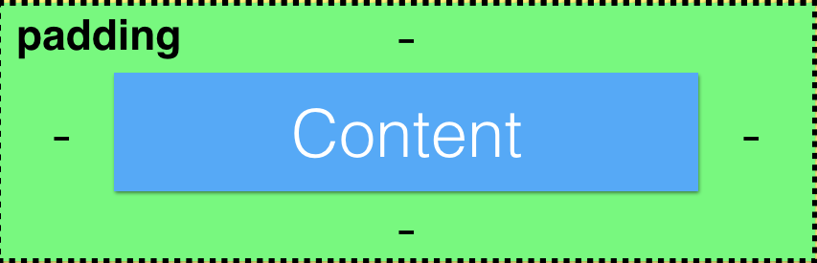
Padding

Slide 4
Padding
padding-left: 10px;
padding-top: 10px;
padding-right: 10px;
padding-bottom: 10px;
padding: 10px;
padding: 10px 10px;
padding: 10px 10px 10px 10px;

Slide 5

Margin

Slide 6
Margin
margin-left: 10px;
margin-top: 10px;
margin-right: 10px;
margin-bottom: 10px;
margin: 10px;
margin : 10px 10px;
margin : 10px 10px 10px 10px;

Slide 7
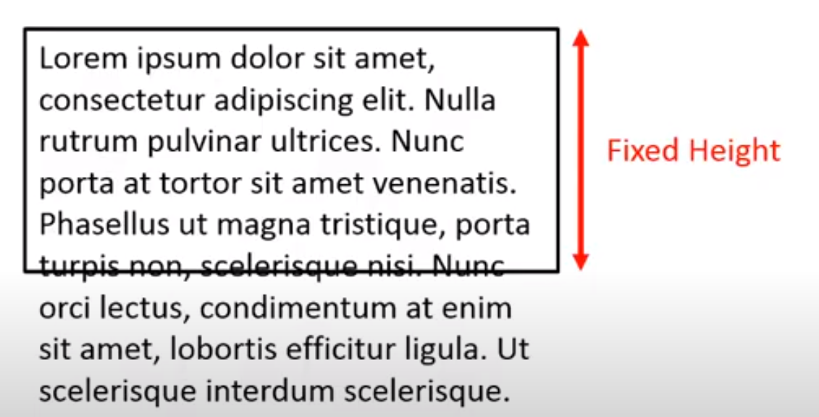
OVERFLOW

Slide 8
OVERFLOW
overflow: hidden;
overflow: Auto;
overflow: Scroll;
overflow: visible;
overflow;
overflow-x;
overflow-y;

Slide 9
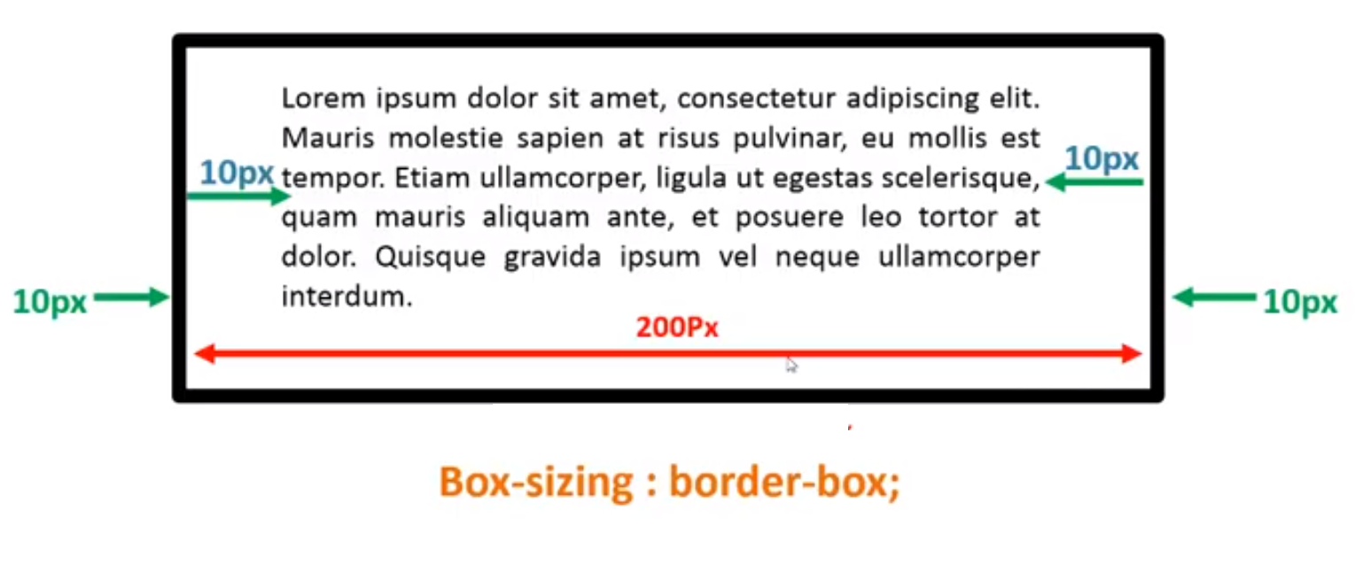
BOX-SIZING
box-sizing: border-box;

Slide 10
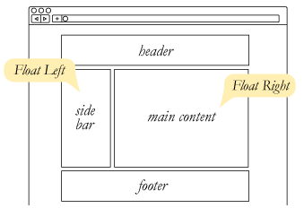
Float
float: none / left / right;

Slide 11
Clear
clear: both/ left / right;

Slide 12
Background
background: lightblue url("img_tree.gif") no-repeat fixed center;
background-color: red;
background-image: url("img_tree.gif");
background-repeat: no-repeat/repeat;
background-attachment: fixed;
background-blend-mode: normal|multiply|screen|overlay|darken|lighten|color-dodge|saturation|color|luminosity;
background-origin : border-box|padding-box|content-box|initial|inherit;
background-position: 50% 50%; or background-position: center top;
background-size: 75% 50%:

